Slide 1
Analysis of Public Sentiment of
Shanghai Disneyland
by Using Data Crawling and Logistic Regression
Deng Kaiwen 19433115
Lu Xinyi 19543833
Xu Shibo 19446616
Lei Jiani 19433050
Su Yueqi 19439377
Wei Jiahe 19452462

Slide 2
Analysis
Topic & Motivation
Model & Data
Conclusion

Slide 3
1
Topic & Motivation

Slide 4
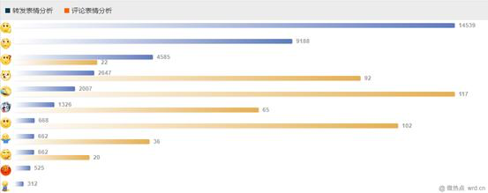
1
Topic & Motivation
Xiao wang, a junior at east China university of political science and law in Shanghai, visited Shanghai Disneyland on jan 30, 2019. Before entering the park, xiao wang spent more than 40 yuan on cookies and other snacks. But at the entrance, xiao wang was forced to turn over bags by the staff, and blocked.
On December 6, Shanghai Disneyland unveiled a new four-tier fare structure, with regular, special, peak and special peak days, instead of the current three-tier fare structure. Among them, the ticket price for some statutory holidays and their related holidays or special peak days is 699 yuan.
52%
bye,bye
90%
Regular day | 399 yuan | Level 1 | Autumn/ winter
Special regular day | 499 yuan | Level 2 | Spring/part weekends
Peak day | 599 yuan | Level 3 | Summer/part weekends/part holidays
Special peak day | 699 yuan | Level 4 | Statutory holidays/other

Slide 5
1
Topic & Motivation
Our group analyzed netizens' attitudes towards Disney through crawling data: how many people supported it, how many people opposed it, and how many people were neutral.
built the model
On the other hand, our team built the model and realized our model to intelligently identify netizens' attitudes published on weibo through the training of crawling data, namely the analysis of public opinions with supervised learning.
analyzed netizens' attitudes

Slide 6
2
Model & Data

Slide 7
2
Model & Data
Aim
Analyze public sentiment
Method
Logistic regression
Event
People’s attitude towards Shanghai Disneyland.
Social platform
Weibo

Slide 8
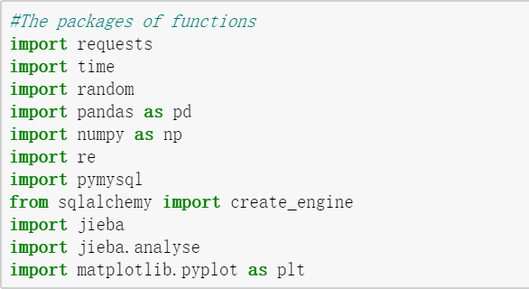
2
Model & Data
key packages
Jieba
dividing a sentence into words
sklearn
LogisticRegression
CountVectorizer (convert text data into feature vectors by Bag-of-word)
1
4
3

Slide 9
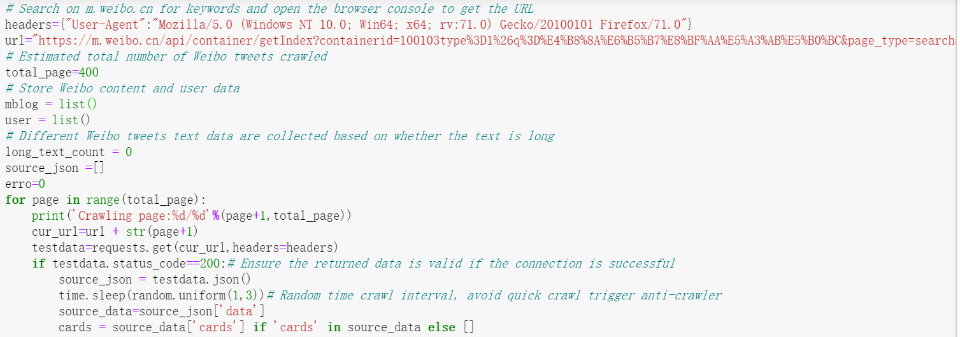
2
Model & Data
① Crawling the data in Weibo
URL comes from the API that we discovered through the changes of XHR when we page

Slide 10
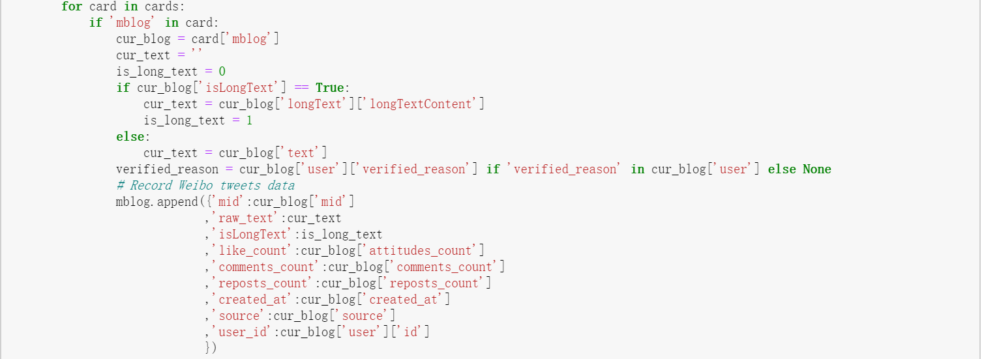
2
Model & Data
① Crawling the data in Weibo

Slide 11
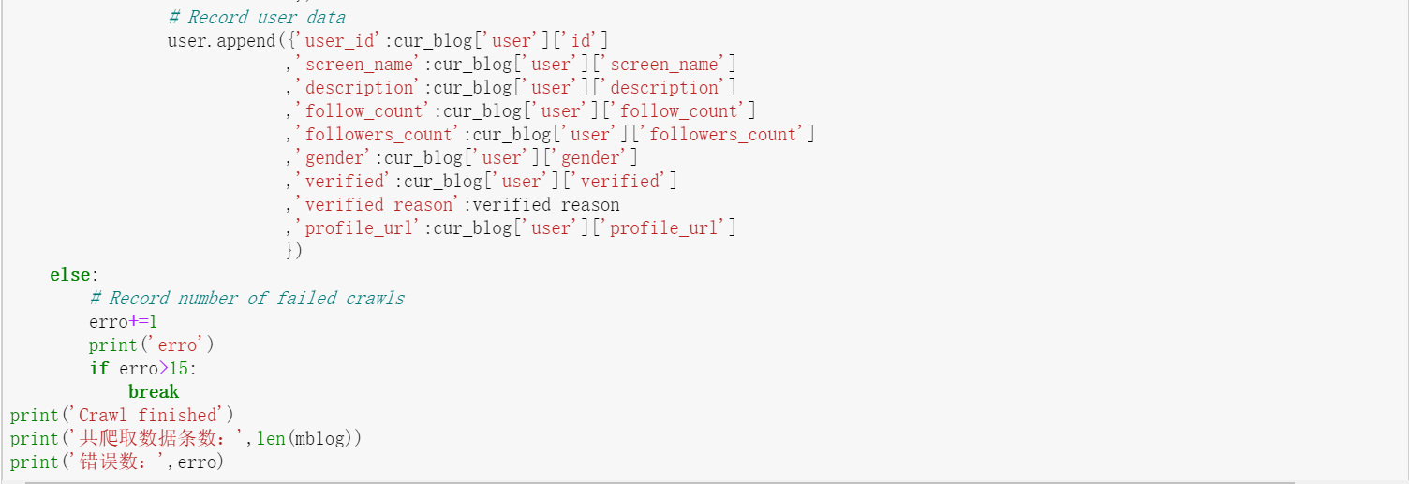
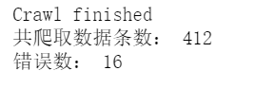
2
Model & Data
① Crawling the data in Weibo
Break point : errors > 15
Get 59 pages including 412 related Weibo tweets

Slide 12
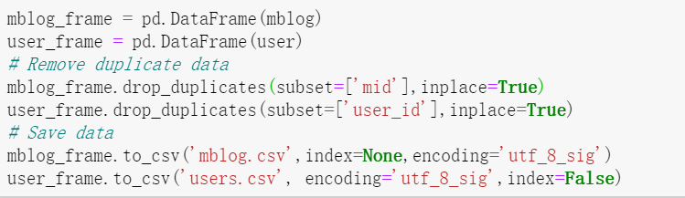
2
Model & Data
① Crawling the data in Weibo
Eliminate duplicate data and save data

Slide 13
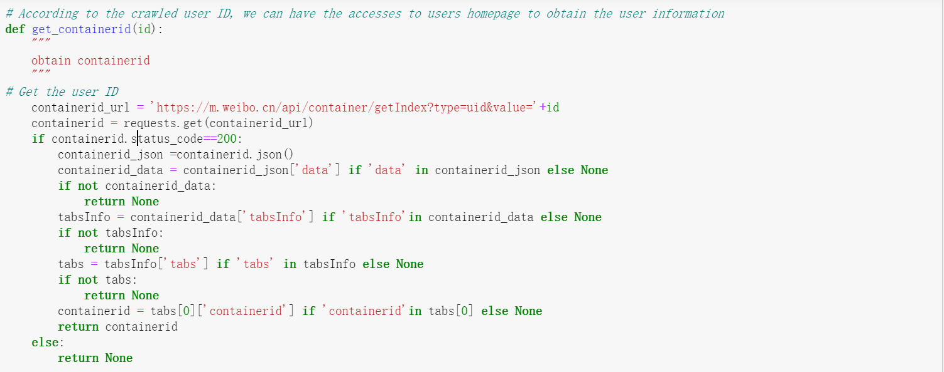
2
Model & Data
② Crawling users' information in Weibo
Use json to store the crawled information

Slide 14
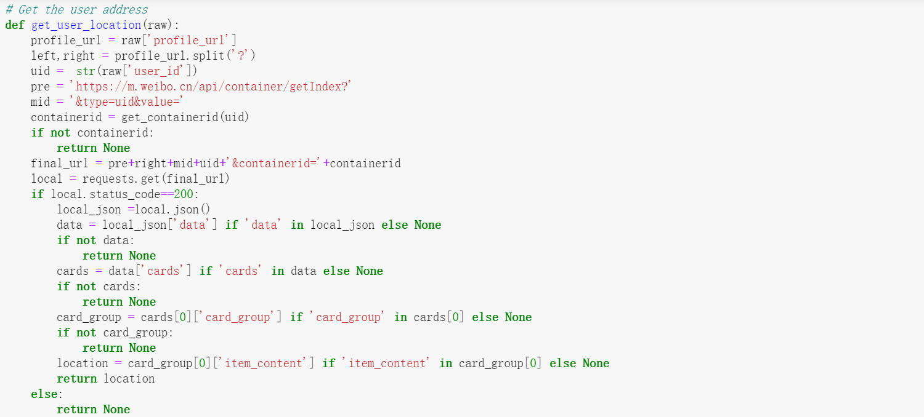
2
Model & Data
② Crawling users' information in Weibo
Replace the ID in the URL to get the access to a particular user's home page

Slide 15
2
Model & Data
② Crawling users' information in Weibo
Get the user’s region

Slide 16
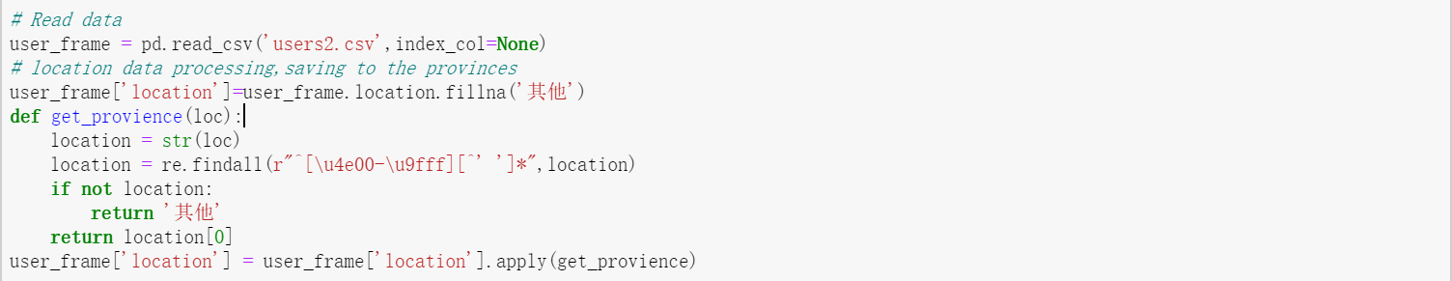
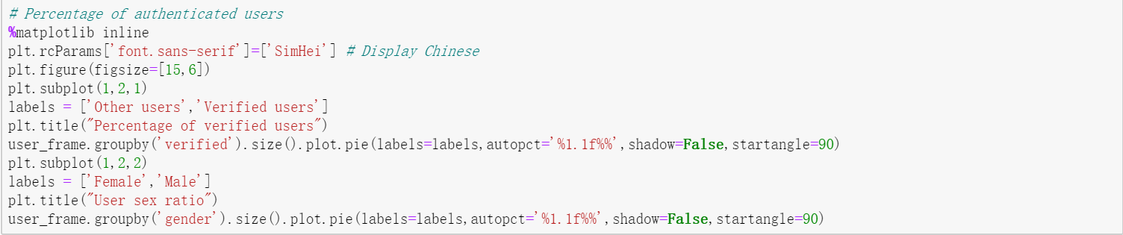
2
Model & Data
② Crawling users' information in Weibo
Get the user’s provinces and genders

Slide 17
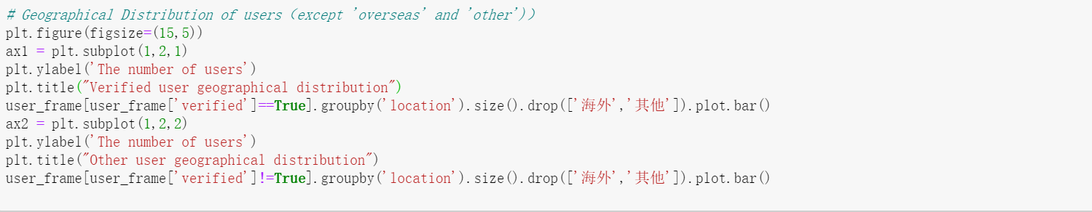
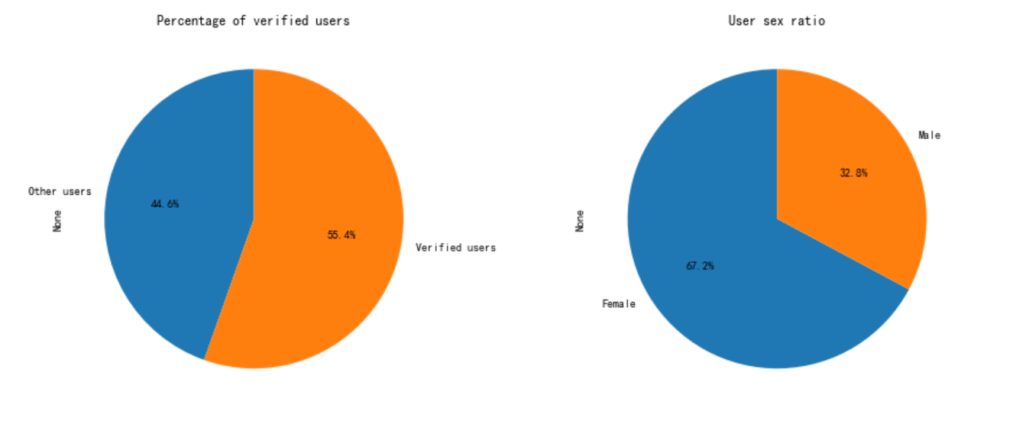
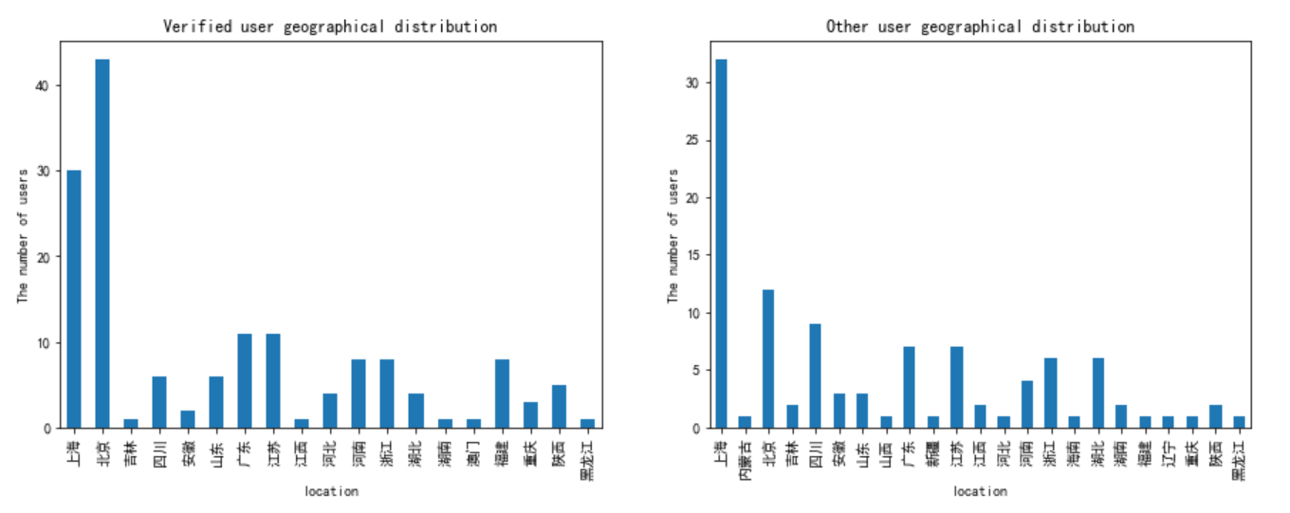
2
Model & Data
② Crawling users' information in Weibo
Geographical Distribution of users（except 'overseas' and 'other’)
Genders

Slide 18
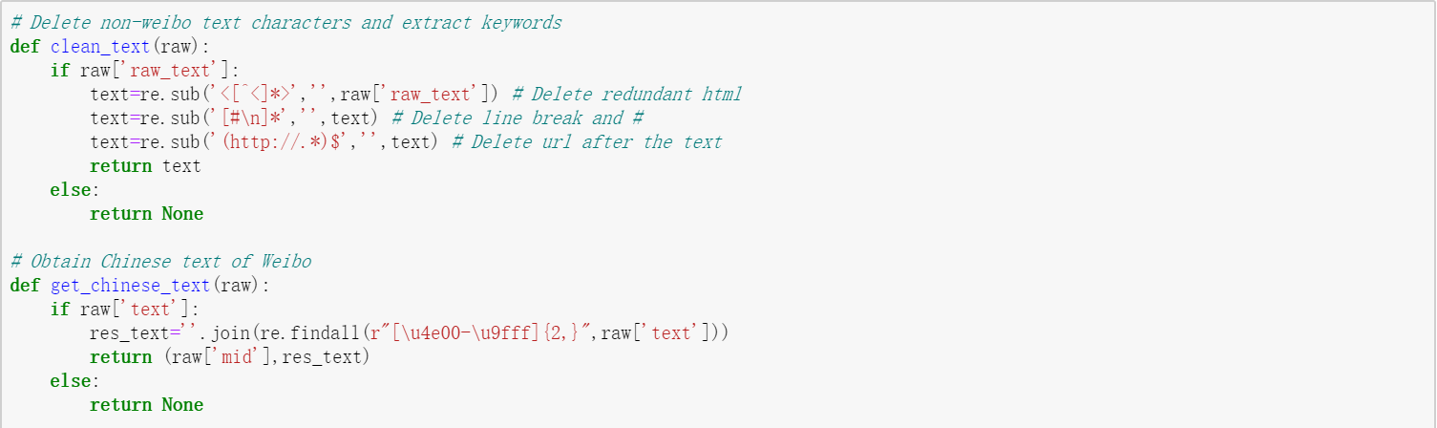
2
Model & Data
③ Data cleansing and keyword extraction
Use regular expression to clean the crawled text
Obtain Chinese text of tweets

Slide 19
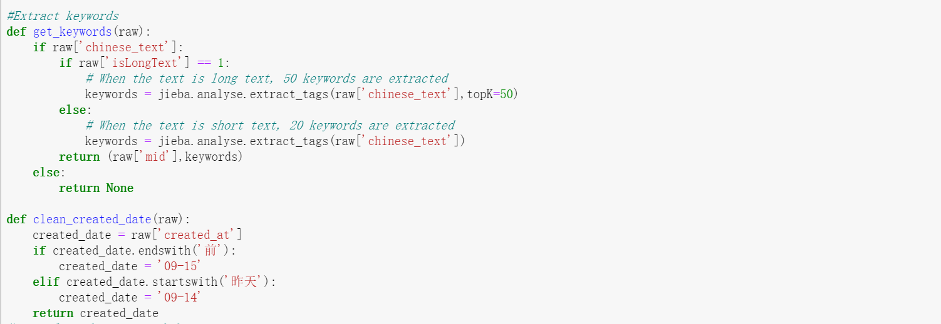
2
Model & Data
③ Data cleansing and keyword extraction
Extract key words
divided in long text and short text
use jieba to split Weibo text into several Chinese words
use Counter to count the frequencies of keywords

Slide 20
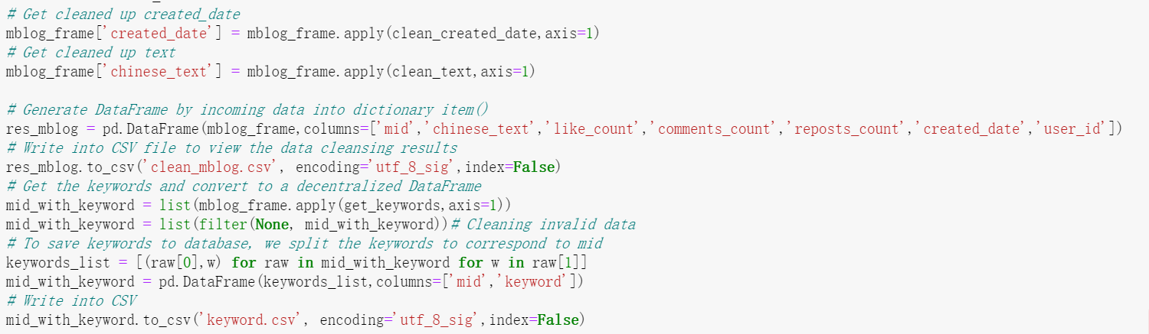
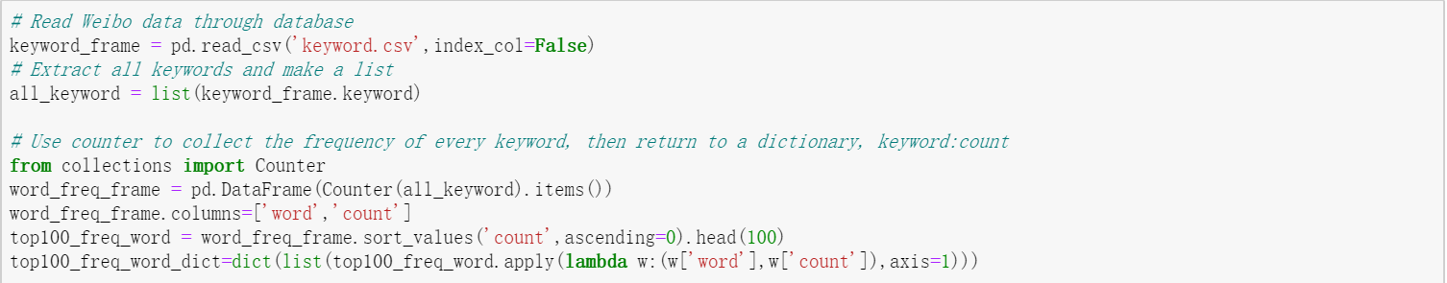
2
Model & Data
③ Data cleansing and keyword extraction
Extract key words
use Counter to count the frequencies of keywords

Slide 21
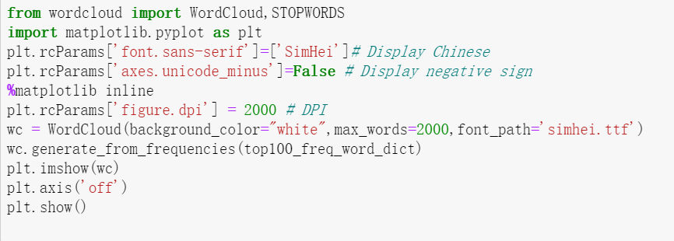
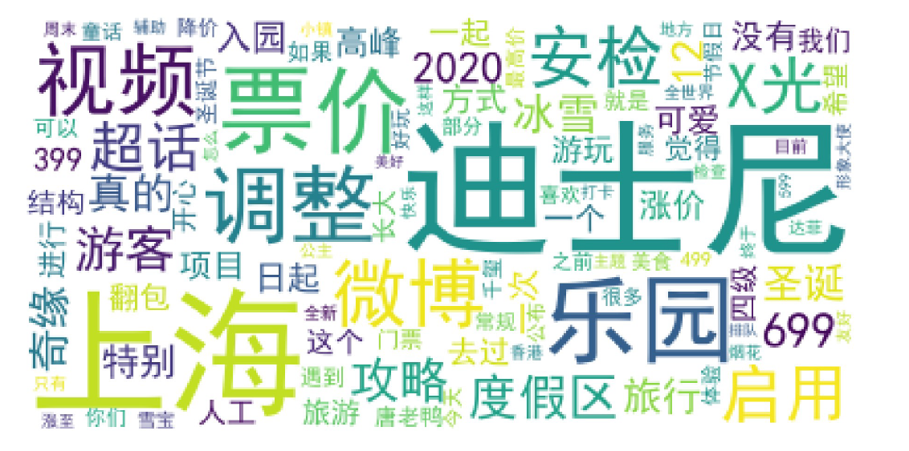
2
Model & Data
③ Data cleansing and keyword extraction
use wordcloud and matplotlib to draw a picture, showing importance of every key word of the topic
1
4
3

Slide 22
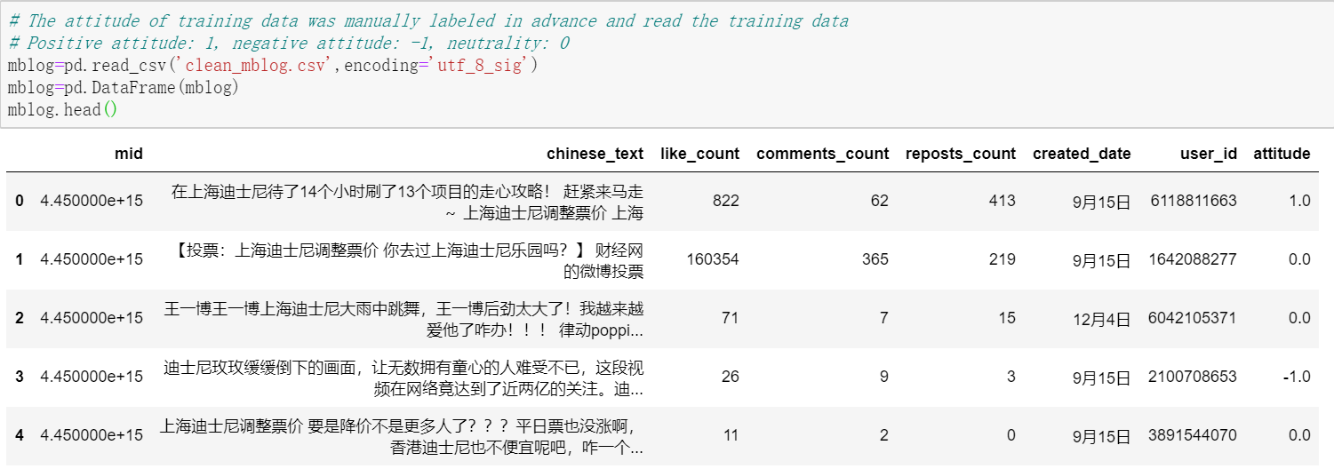
2
Model & Data
④ Training the model
manually labeled the text in advance
1 for positive attitude toward Shanghai Disneyland, -1 for negative attitude, and 0 for neutrality and some advertisements
1
4
3

Slide 23
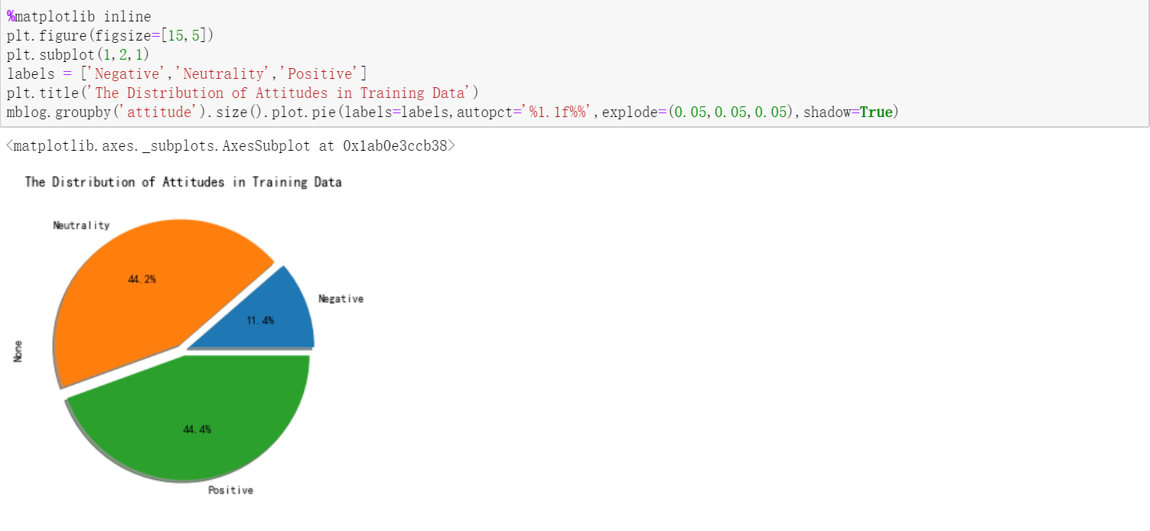
2
Model & Data
④ Training the model
Results of the training data
1
4
3

Slide 24
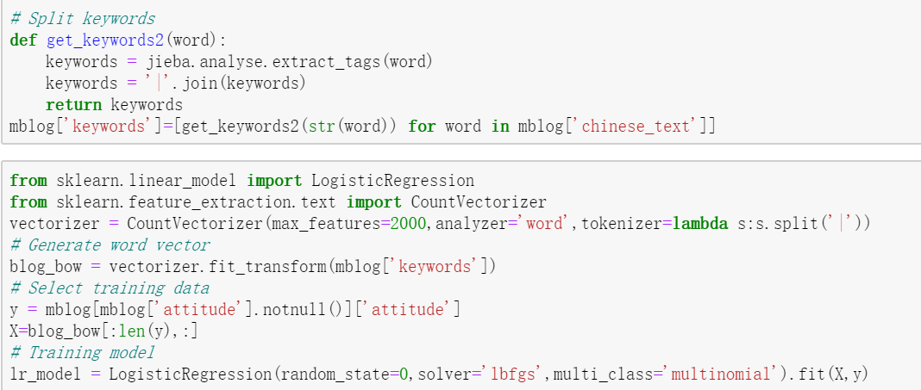
2
Model & Data
④ Training the model
Use jieba and CountVectorize to turn all the keywords into a feature vector to form a word bag
Make logistic regression
Get the model
1
4
3

Slide 25
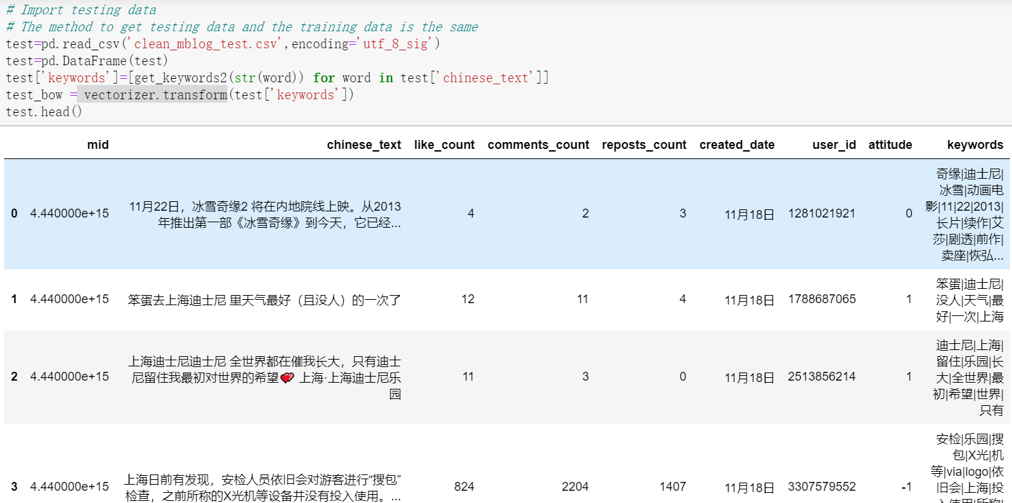
2
Model & Data
⑤ Testing the model
Import testing data just like training data
1
4
3

Slide 26
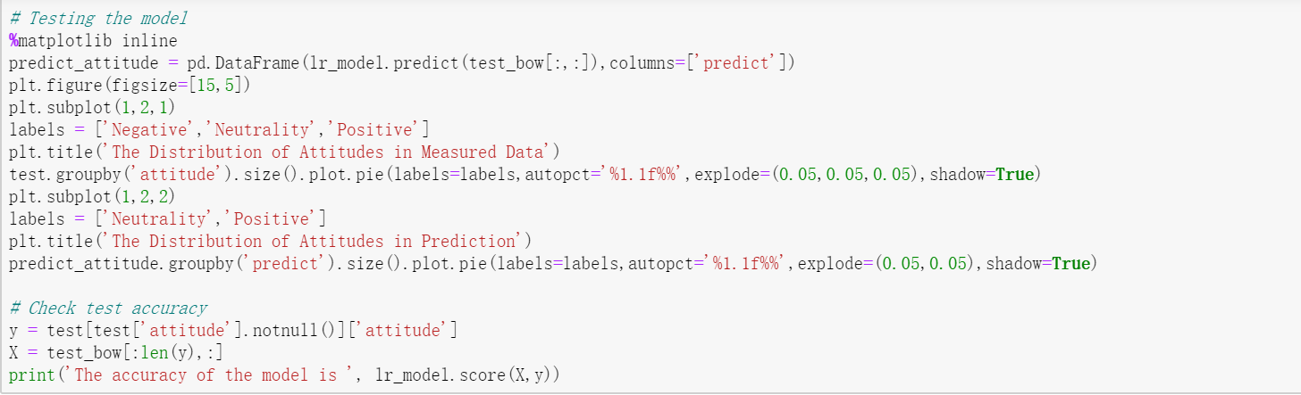
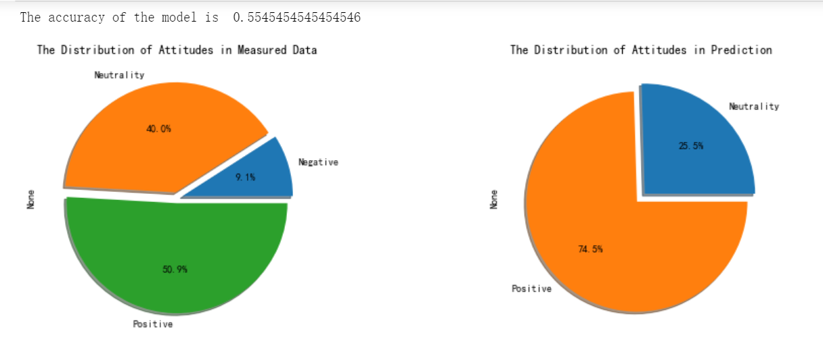
2
Model & Data
⑤ Testing the model
manually labeled the testing data in advance
Comparing testing data and training data to get the accuracy rate
1
4
3

Slide 27
3
Analysis

Slide 28
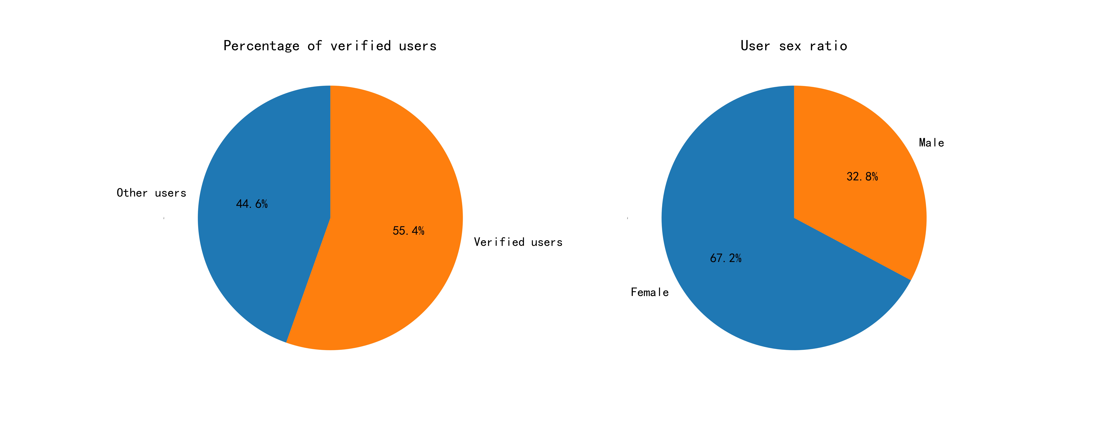
3
Analysis
① Crawled Data of user information in Weibo
1
4
3

Slide 29
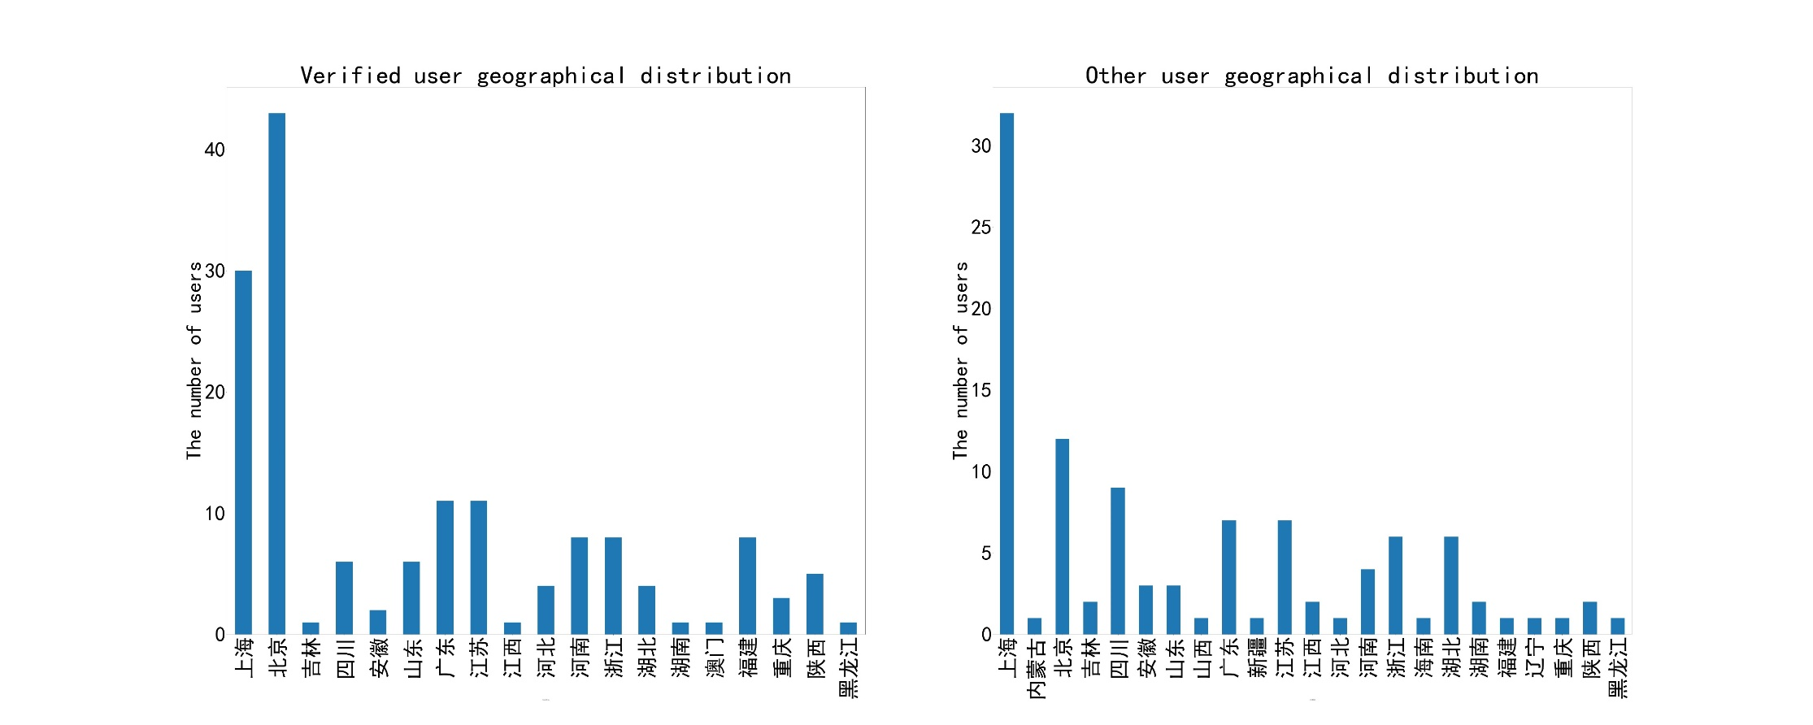
3
Analysis
① Crawled Data of user information in Weibo
1
4
3

Slide 30

3
Analysis
② Keyword Extraction
1
4
3

Slide 31
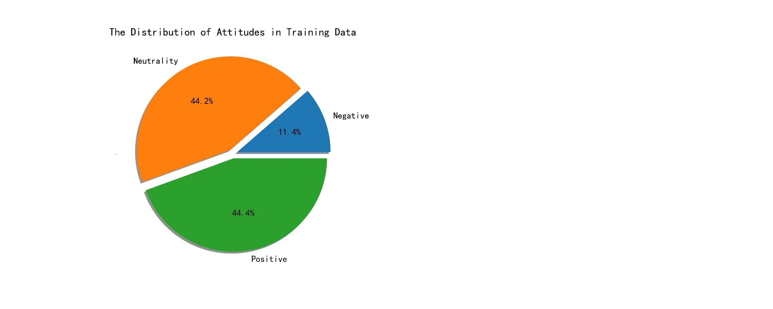
3
Analysis
③ Training the model
Training Data
1 for positive attitude toward Shanghai Disneyland, -1 for negative attitude, and 0 for neutrality and some advertisements
1
4
3

Slide 32
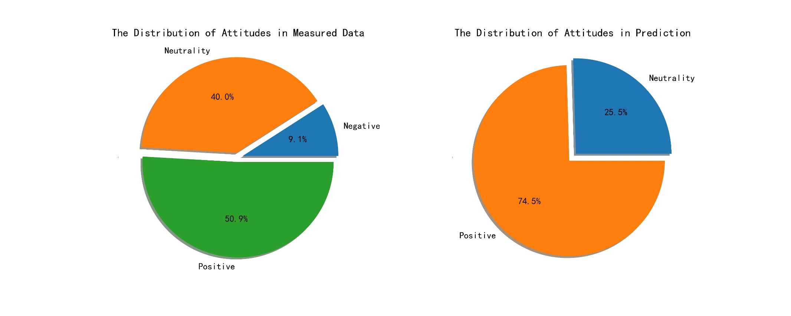
3
Analysis
③ Training the model
Testing Data
1 for positive attitude toward Shanghai Disneyland, -1 for negative attitude, and 0 for neutrality and some advertisements.
1
4
3

Slide 33
3
Analysis
The main reasons for the low accuracy of the model
Improvement measures
Problems In Training Data Set
Problems In Testing Data Set
Improvement measures

Slide 34
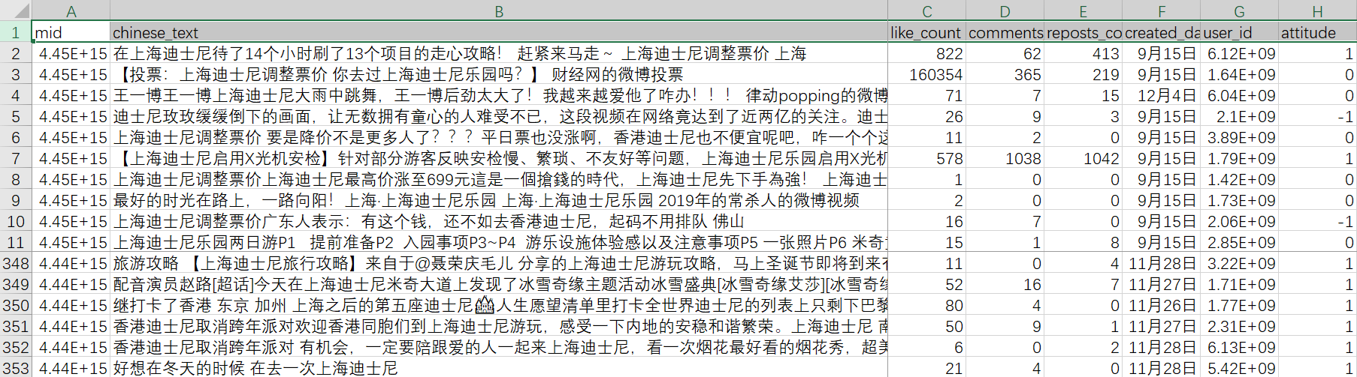
3
Analysis
① Problems in Training data
The amount of data in the training set is not large enough.
In the selection of data, there are some non-relevant data and irrelevant cases.
1
4
3

Slide 35
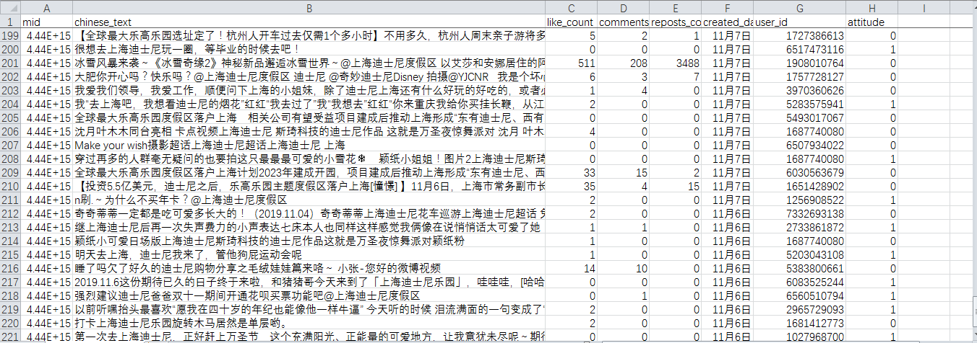
3
Analysis
② Problems in Testing data
In the manual labeling of training data and test data, human subjective judgment in data classification, which has a certain degree of influence on the results.
The test data crawl is the data sorted after the training data on the search page, and the similarity with the keywords itself is lower than the training data.
1
4
3

Slide 36
3
Analysis
③ Improvement measures
1
More data needs to be considered for training to make the data prediction more accurate.
Eliminate unrelated Weibo, improve data collection accuracy.
4
3

Slide 37
4
Conclusion

Slide 38
4
Conclusion - Reason of the research
Disney launched its Shanghai campus on 2016, and is targeting more openings in China
T
D
The mandatory bag search which is only enforced in China
The rapid admissions price increase over the past two years
C
B
Disney is facing public relation challenges, associated with two of its recent controversies
The research adds value to help executives from Disney to analyze the current situations, and come up with the appropriate remedies.
A

Slide 39
4
Conclusion - Method of the research
Analyze the profile of users who are interested in the keyword “Disney”
Data is retrieved by visiting the population Chinese social media website- WeiBo, and search the keyword “Disney”
Use python to extract data associated with the search, including the user’s ID, sex, geographical location and historical posts
From the identified users, extract their preference and postings, as well as their “Liked” posts and areas

Slide 40
4
Conclusion - Findings
Generally, our model found that people are either neutral or positive against Disney.
Such as, we do not believe the recent public relations challenges affected Disney’s perceived image in China.

Slide 41

4
Conclusion - Caveats and Areas of improvements
The accuracy of the model was not satisfying. This is due to two major reasons:
The inadequacy and lack of available data.
The python model is not fully functional to deal with outliers.
There are too many non-related data that are fed into the model. Search on Disney returns too many data, and many of which are not related to the public relation issues that we try to handle.

Slide 42
THANK
YOU

